Slide 1
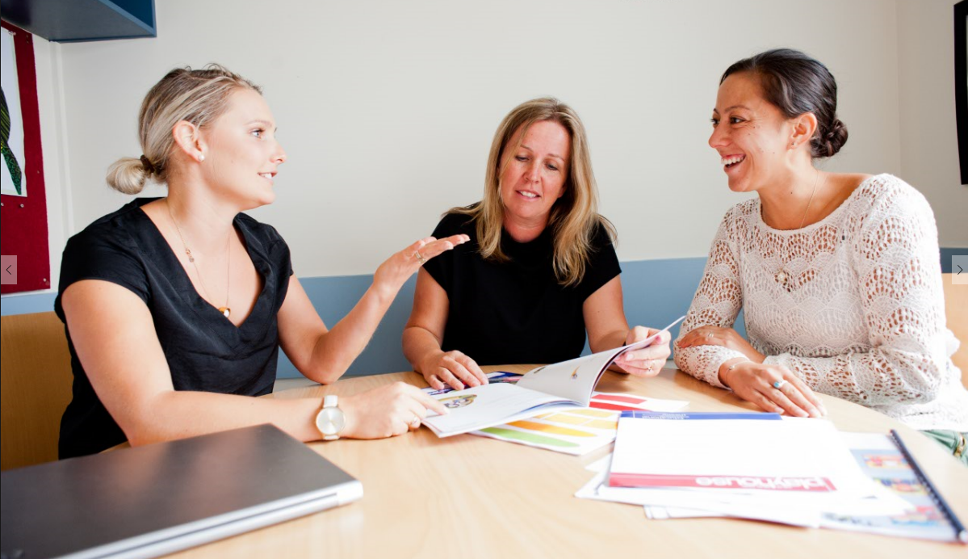
Teachers and Teacher Aides Working Together
Keeping Our Work Confidential, Professional and Safe
Module 2 Presentation

Slide 2
Introducing the module
This module is about confidentiality, safety and professional behaviour at work.
It is for both teachers and teacher aides.
Please take your time to think and reflect.

Slide 3
Why this module?
Working together in a professional relationship requires teachers and teacher aides to identify the ways they are connected, at school and in the wider community.

Slide 4
When professional and private lives overlap
It’s good to know your students well.
However, it can also be tricky to work in the same community you live in.
There can be conflict between your role as a professional and the roles you play in your personal life.
When talking about school matters in a social situation, what is your role? A friend or community member? Or a teacher or teacher aide?

Slide 5
Knowing the Privacy Act 2020
Practice must comply with the Privacy Act 2020.
Keep information you learn about students, families and whānau private and confidential.
Only share information with those supporting the student at school.
The information must be relevant.

Slide 6
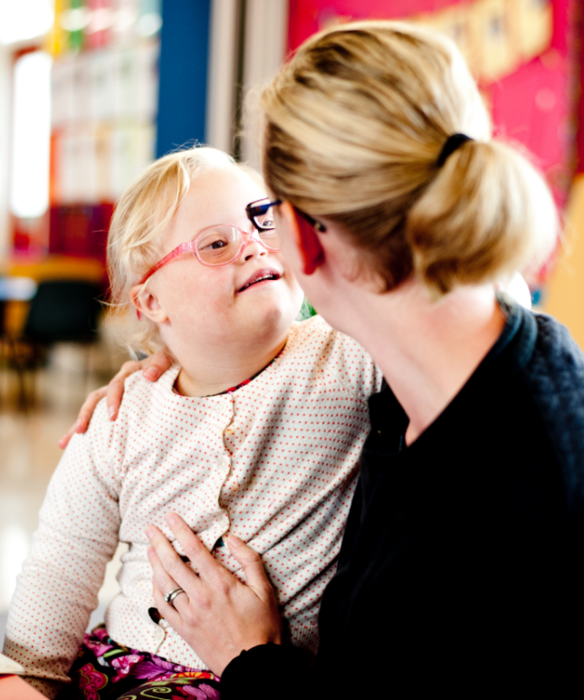
Creating partnerships with families and whānau
Show respect for students’ privacy in how you communicate with their families and whānau – value their knowledge and input.
Be clear on the right time and place for conversations with families and whānau.
Some conversations will be appropriate for the teacher to have and others for the teacher aide to have – reach agreement on this.

Slide 7
Knowing what to do for a student whose safety or well-being may be at risk
Sometimes the need to protect privacy can conflict with concerns that a student is at risk of harm.
Know your school’s guidelines for confidentiality.
If you believe a student is at risk, it is your responsibility to discuss your concerns with senior management.

Slide 8
Keeping yourself safe
Follow your school’s health and safety policies.
Get specialist training if you provide personal or physical care for students.
Consider your own safety, especially when working with older students.
What are the risks to your safety at work? What helps to keep you safe?

Slide 9
Working as a team
Working together effectively in a busy classroom requires a strong collaborative relationship:
identify any conflict areas
clarify expectations
agree on how to raise any issues
agree on how to problem-solve issues.

Slide 10
Keeping up the good work
Regular meetings help build and maintain your professional relationship.
Meetings provide opportunities to:
reflect
celebrate
problem-solve
plan.
What do you do to keep your professional relationships in good shape?

Slide 11
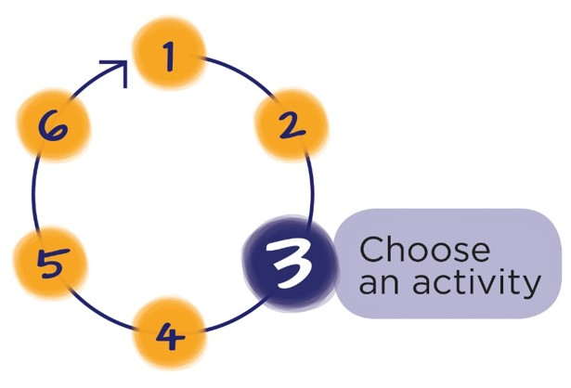
Next Step
Download the workbook for this module at: teachersandteacheraides.tki.org.nz/Our-roles/Module-2
To find out more about Teachers and Teacher Aides Working Together and to access the other modules go to: teachersandteacheraides.tki.org.nz
We wish you well in your learning!
Ngā mihi!
It’s time to choose an activity from the workbook for this module.

